Slide 1
Uwatch digital forensic tool
A secure tool to help with crime investigations

Slide 2
Overview
The system we are developing comprises of two main components the mobile application for citizens and a desktop application which is for law enforcement and judiciaries.
Our system is security based so we will design the system to be secure from ground up.
The system is a tool which will help law enforcement by producing authentic evidence.
The authenticity the tool provides will hopefully allow the evidence captured by the system to be admissible when presenting it in court.
We plan on maintaining confidentiality , integrity and availability of our system.
There are limitations to which our system will be able to identify valid digital evidence because of image recognition limitations.

Slide 3
Two main components of our system
The mobile version of our system is for citizens to record PDE(Potential digital evidence) and upload it for juries to use in court cases.(assuming the court system finds encryption and other security mechanisms admissible for maintaining integrity of the evidence.)
The juries and law enforcement view the evidence using the desktop version of our application.

Slide 4
Authenticity of Evidence
The authenticity of evidence will be based on the location evidence has been recorded as well as the timestamp and a digital signature which each piece of evidence will have when validated by the system.
The digital signatures will provide a sense of authenticity to the court system(since they are mainly focused on the integrity of the data).
Seeing that the timestamp of the data matches the time it was uploaded and the locations match the data may be admissible to be provided as evidence in the court of law.

Slide 5
CIA
Confidentiality of the data – No unauthorized party should be able to view digitial evidence stored by the system.
Integrity of the data – Data should not be tempered with(this is a core requirement of our system, since this is of utmost importance to the court system)
Availabality of the data - the judiciary and law enforcement should have access to data whenever they find it of need.

Slide 6
Limitations
In terms of validation of PDE we will be focusing on face recognition in images and certain objects found in crimes.
We will not be handling video and audio PDE validation because the accuracy of object and voice recognition in artificial intelligence is underdeveloped.
These will be nice to have features we will build on if time permits.

Slide 7
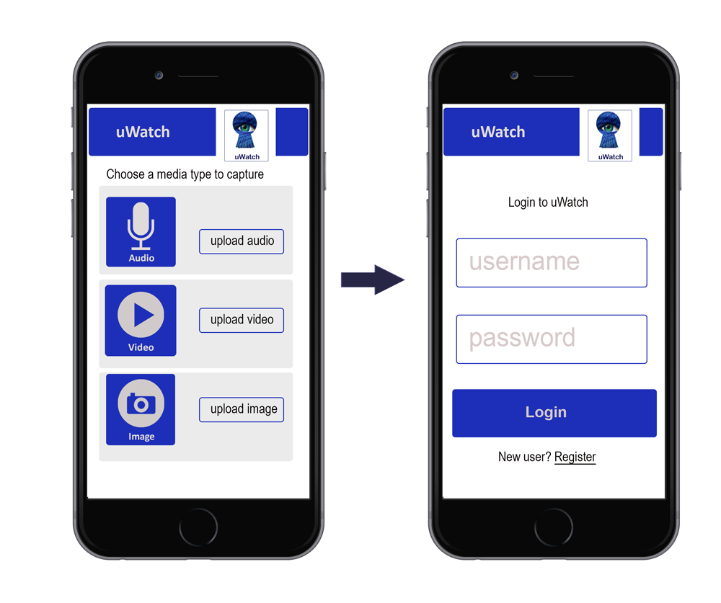
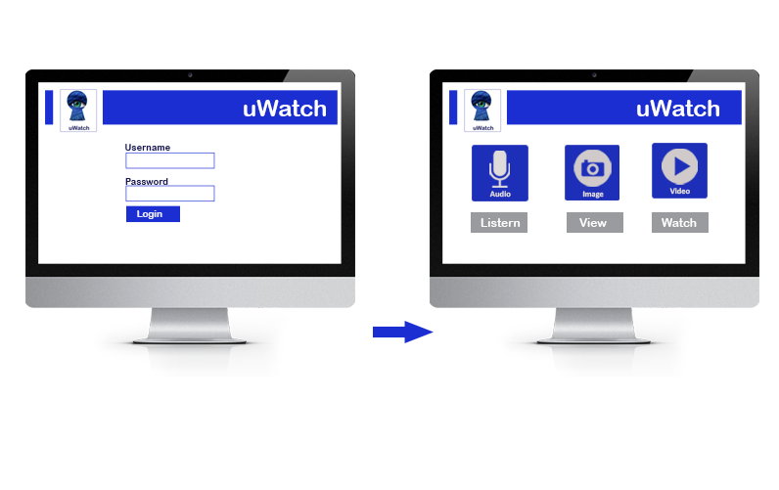
Prototype WITNESSES APPlication

Slide 8
DESKTOP VERSION FOR LAW ENFORCEMENT & JUDICIARY

Slide 9
METHODOLOGY
We plan on using agile approach since the system may need to change in future.
This incremental approach allows us to test each of the small components of the system independently
Changes in the requirements may be made in this approach so maybe our limitations changing in the implementation phase will not be a problem
We plan on using java EE since our team is more comfortable in the java environment even though django python is said to have faster implementation. Also we have done minor research in the security aspects of java EE and feel assured by the various security frameworks provided.

Slide 10
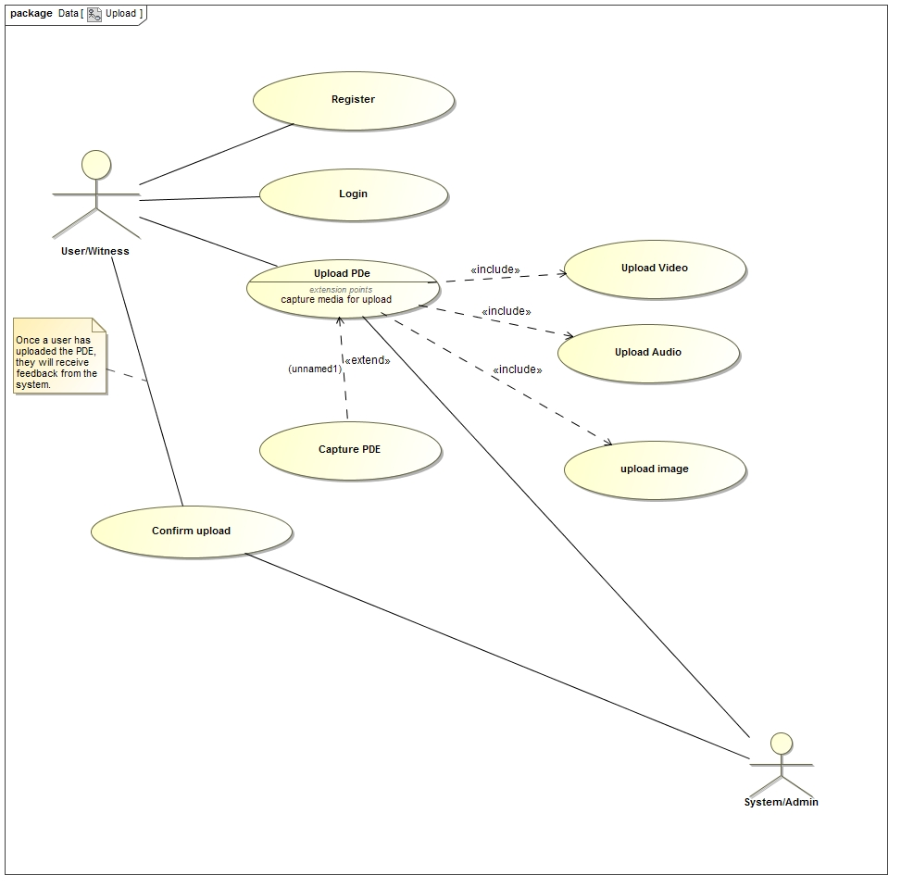
Functional requirements: upload

Slide 11
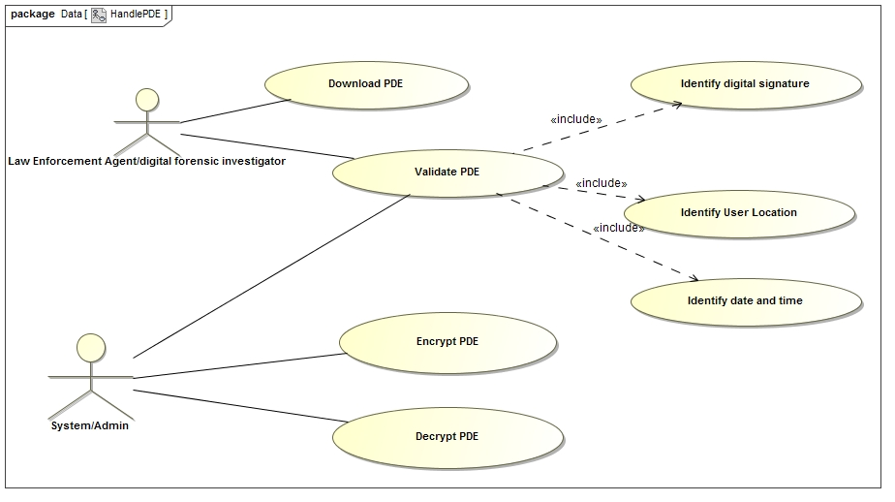
FUNCTIONAL REQUIREMENTS: Download

Slide 12
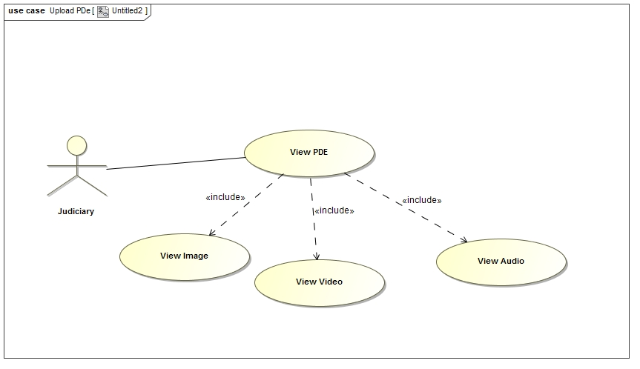
FUNCTIONAL REQUIREMENTS: VIEW

Slide 13
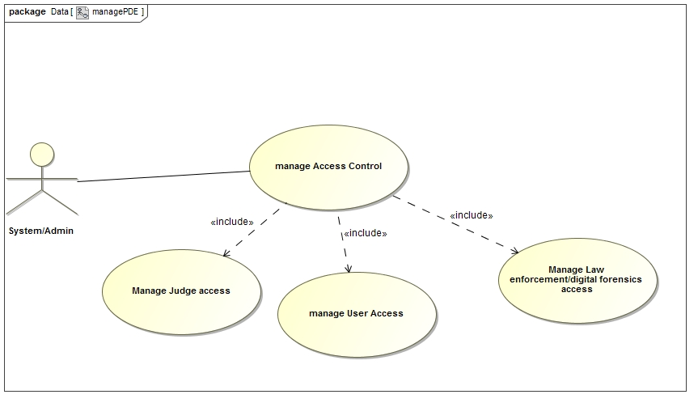
Functional requirements: access control

